Slide 1
ASPE 2020 Student Challenge Recognitions
Wednesday Oct 21, 2020 - Business Meeting

Slide 2
Agenda
Recognize Sponsors.
Third Place Team.
Second Place Team.
First Place Team.
Special Recognitions.
Call for participation.
Organizing Committee.

Slide 3









2020 Student Challenge Sponsors
Platinum sponsors
Gold sponsors
Silver sponsors

Slide 4
Slide with Third place Team Pictures and names. Also include a picture of device.

Slide 5
Slide with Second place Team Pictures and names. Also include a picture of device.

Slide 6
Slide with First place Team Pictures and names. Also include a picture of device.

Slide 7
Slide with special recognition

Slide 8
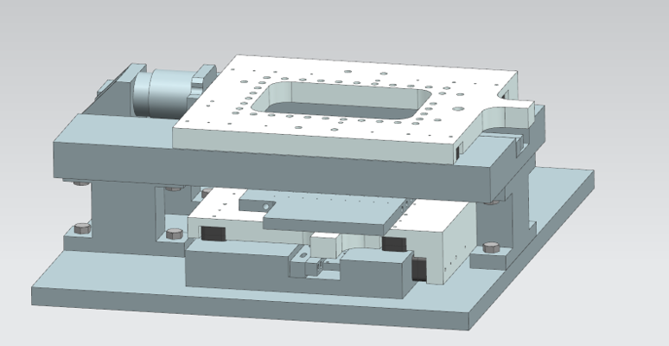
Benefits for the students:
Mention here the pluses of forming a team:
Get an opportunity to collaborate with the society – from other universities and from experienced ASPE members.
Learn to take a project to completion in a few hours by delegating and by designing simple solutions.
Typically the challenge will help students with registrations and some tutorials.
First place to third place get various opportunities and monetary recognition.
…..

Slide 9
2021– Want to participate?
In 2021, we will be scribing gratings using a diamond tool. (Mention here the array of activities done by the committee)
Testing the hardware to make sure is doable.
Design/Building sensors/actuators/tools.
Looking for ways to have the students learn the basics.
Help developing software templates that the students can use.
Do tutorials around the student gaps for the particular event.
Do consulting sessions with the students.
Develop the grading rubric.
Sponsor and call other sponsors.
Judge design and final presentations.
We need wide array of levels of expertise in the Committee. (Manufacturing, Mechanical, Metrology and Controls)

Slide 10
Organizing Committee:
Luis A. Aguirre, 3M Company
Kumar Arumugam, University of North Carolina-Charlotte
Marcin Bauza, ZEISS Industrial Quality Solutions
Raymond C. Cady, Corning
Jacob Cole, University of North Carolina-Charlotte
Tim Dalrymple, Independent
Mark Kosmowski, ESI
Byron Knapp, Professional Instruments Company
Rafael Marangoni, NIST
Robert Panas, LLNL
Nilabh Roy, Canon Nanotechnologies.
Stuart T. Smith, University of North Carolina-Charlotte
Alex Sohn, Facebook Reality Labs

